Slide 1



Network Segmentation Effectiveness for PCI DSS Scope Reduction
Prepared by : Mr. THY Dayuth
Academic Advisor : Mr. MEAS Sothearath
Company Supervisor : Mr. PHOK Visal
Period : 3 Months (20 April – 20 July 2026)
Academic year : 2026 ~ 2027
1
Notes:
1

Slide 2
CONTENTS
1
Introduction
5
Finding
Conclusion & Recommendation
2
Project Description
6
3
Literature Review
7
References
4
Methodology
2

Slide 3

Introduction
Project Description
Literature Review
Methodology
Finding
Conclusion & Recommendation
References
Company Profile
ACLEDA Bank Plc.
Secure, innovative, and ethical financial services sustainably
January 19, 1993
One of Cambodia’s largest and most prominent commercial banks
leading and the most trusted commercial bank
Loans, Deposits, and Money Transfers
3

Slide 4
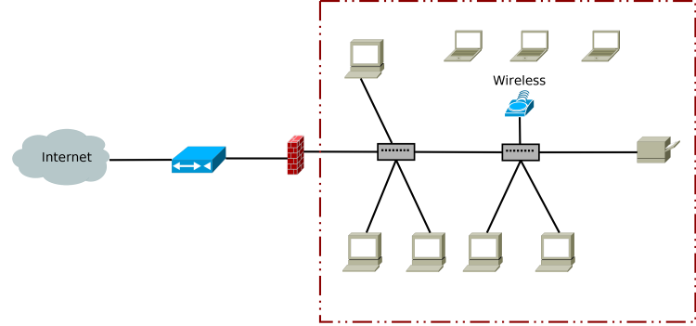
Introduction
Project Description
Literature Review
Methodology
Finding
Conclusion & Recommendation
References
Problem Statements
Flat Network Architecture
Simplicity and Ease of Deployment
Low Operational and Hardware Costs
Unrestricted Communication and High Throughput
Flat Network Topology
4

Slide 5
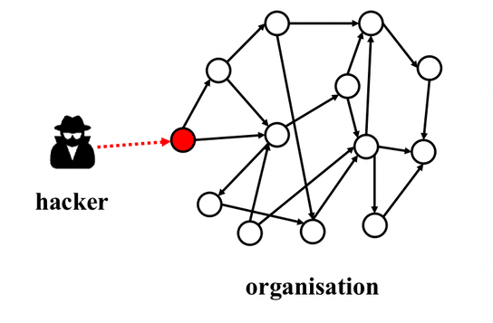


Introduction
Project Description
Literature Review
Methodology
Finding
Conclusion & Recommendation
References
Problem Statements
Security Impact
Operation Impact
Unauthorized Access
Lateral Movement
Higher Audit Effort
5

Slide 6



Introduction
Project Description
Literature Review
Methodology
Finding
Conclusion & Recommendation
References
Objectives
Validate Control Effectiveness
Segment the Payment Path
Protect Account Data
6

Slide 7

Introduction
Project Description
Literature Review
Methodology
Finding
Conclusion & Recommendation
References
Scope of Projects
Exclude:
Live Card Data
Production Banking
Formal PCI DSS Certification
Docker-based PCI DSS Segmentation Lab
Secured Transaction Path POS - CDE
Implement Controls Aligned Security Controls
Validate its Effectiveness and Gather Evidence
7

Slide 8
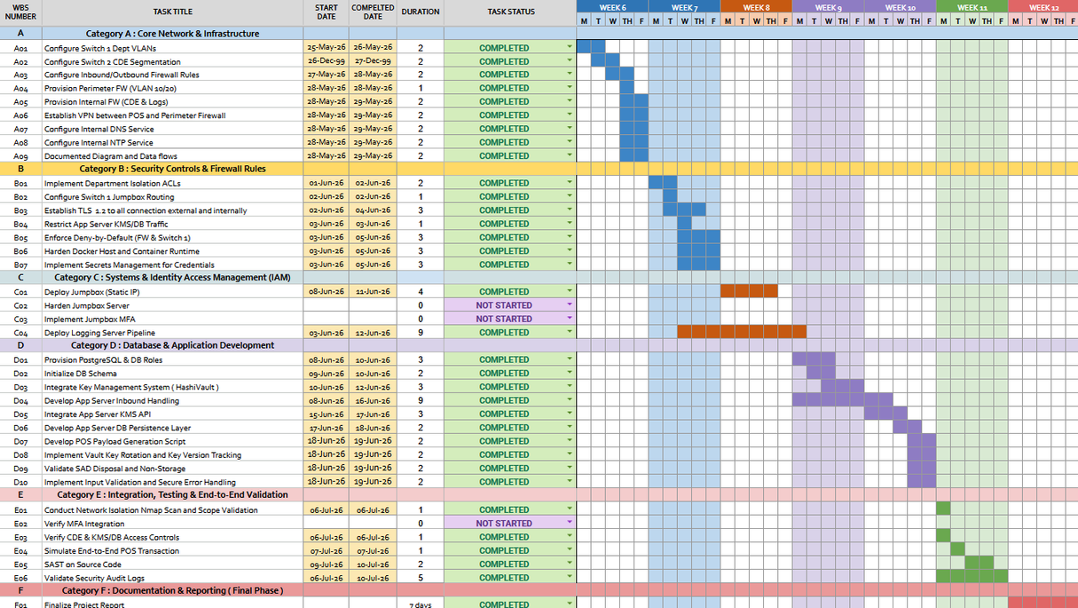
Introduction
Project Description
Literature Review
Methodology
Finding
Conclusion & Recommendation
References
Project Planning
Requirements and Scope
Architecture and Data Flow
Segmented Deployment
Control Integration
Security Validation
Evidence and Reporting
8

Slide 9
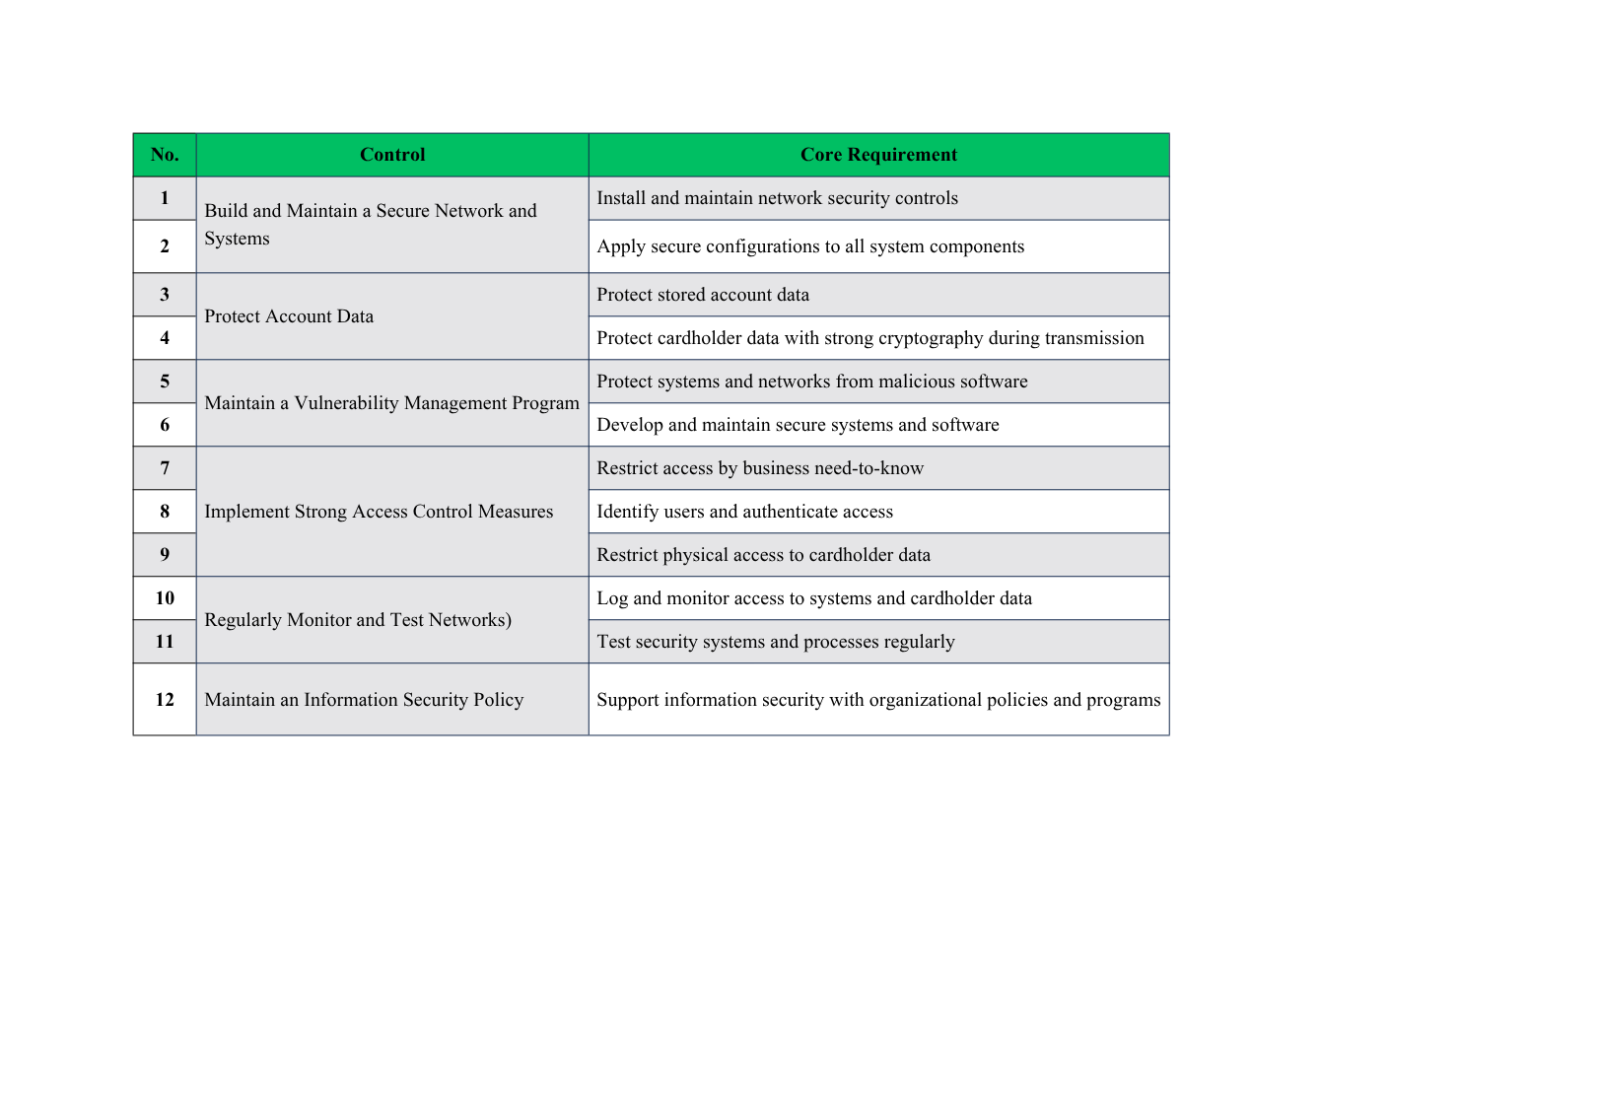
Introduction
Project Description
Literature Review
Methodology
Finding
Conclusion & Recommendation
References
Literature Review
PCI DSS v4.0.1
6 Controls Objectives
12 Principal Requirements
249 Detailed Requirements
9

Slide 10
Introduction
Project Description
Literature Review
Methodology
Finding
Conclusion & Recommendation
References
Literature Review
Network Segmentation
Isolates CDE reduce PCI DSS scope when properly enforced and tested.
Least Privilege Connectivity
Allows only approved traffic and denies all other connections by default
Data Protection
Protects PAN with encryption, tokenization and prevent CVV storage.
Control Validation
Uses logs, vulnerability scans, and segmentation tests to verify controls
Sources: PCI SSC (2017, 2024) • Mhaskar et al. (2021) • Wang and Rey (2026)
10

Slide 11









Introduction
Project Description
Literature Review
Methodology
Finding
Conclusion & Recommendation
References
Technology Used
Orchestration
Retail VPN
Firewall Enforcement
Reverse Proxy
Payment Processing
Cryptographic Services
Database
Centralized Logging
Anti
Malware
11

Slide 12
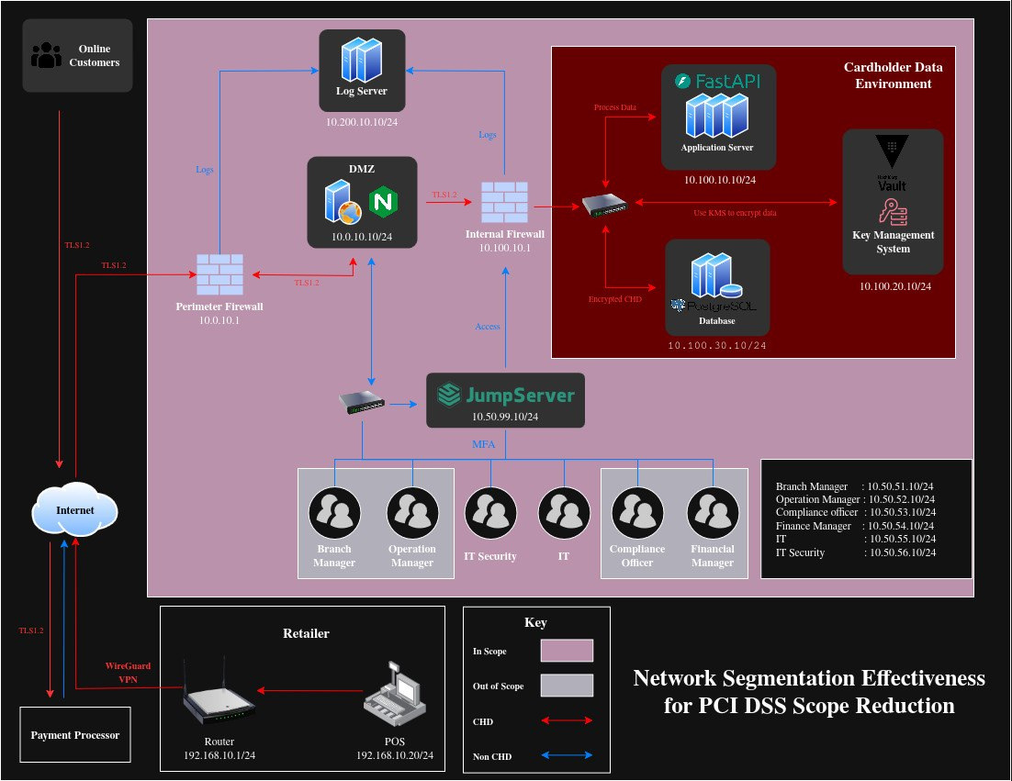
Introduction
Project Description
Literature Review
Methodology
Finding
Conclusion & Recommendation
References
Diagram
System Diagram Overview
12

Slide 13
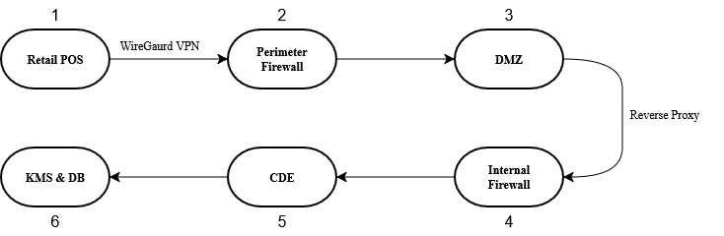
Introduction
Project Description
Literature Review
Methodology
Finding
Conclusion & Recommendation
References
Approved Path
Transaction Which Made Outside of Define Path Be Denied
13

Slide 14
Introduction
Project Description
Literature Review
Methodology
Finding
Conclusion & Recommendation
References
Implementation
Segment Security Zones
Enforce Secure Access
Supporting Controls
Design Transaction Flow
Document Communication
Gather Evidence To Backup Claims
1
2
3
4
5
6
Analyze Requirements and Scope
Build Core System
Validate Effectiveness
14

Slide 15
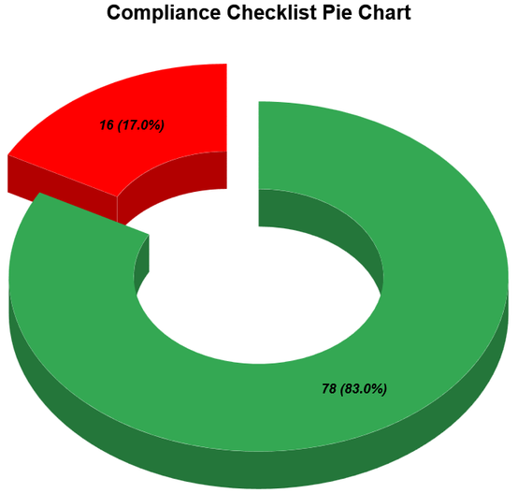
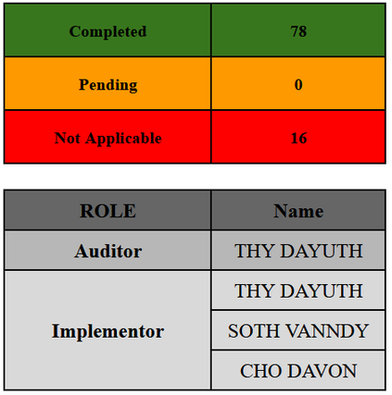
Introduction
Project Description
Literature Review
Methodology
Finding
Conclusion & Recommendation
References
Results
Secured Transaction
Any Activities are Logged as Artifacts
Defined Zone based on Security Level
Comply with 78 selected sub-requirements
15

Slide 16
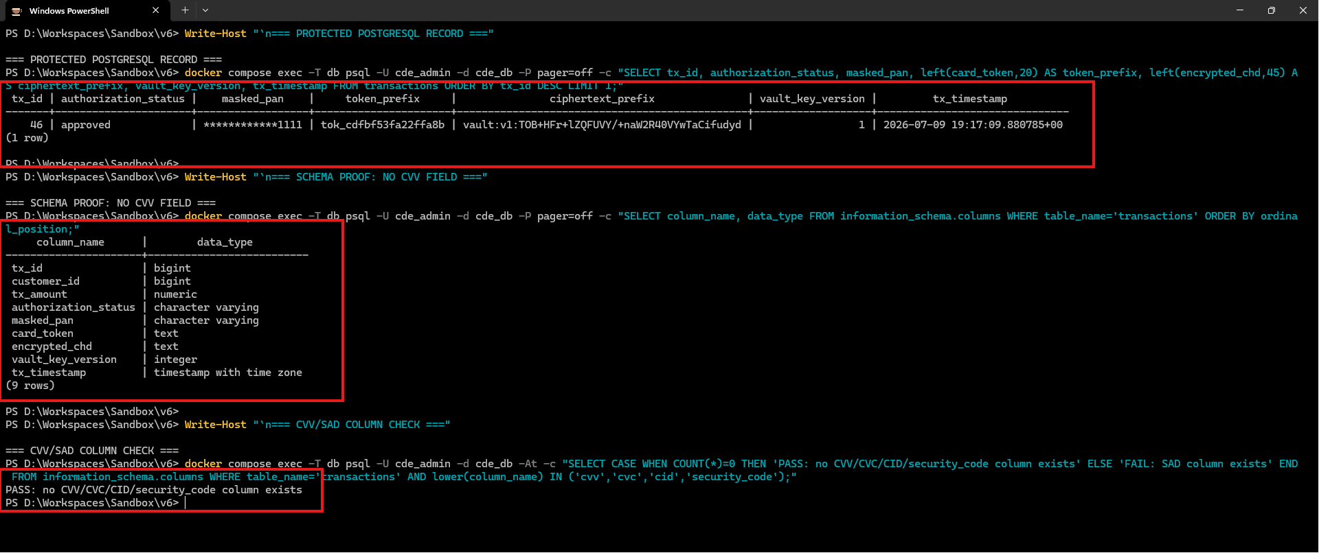
Introduction
Project Description
Literature Review
Methodology
Finding
Conclusion & Recommendation
References
Finding
Database Masking and Encryption with Tokenization
16

Slide 17
Introduction
Project Description
Literature Review
Methodology
Finding
Conclusion & Recommendation
References
Challenges
Maintaining consistency between implementation, documentation, and evidence.
Allowing required services without weakening CDE segmentation.
1
2
Troubleshooting firewall, routing, TLS, and service dependencies.
Producing valid evidence without overstating PCI DSS compliance.
3
4
17

Slide 18

Introduction
Project Description
Literature Review
Methodology
Finding
Conclusion & Recommendation
References
Perspectives
What I Learned
PCI DSS Scoping and Procedures
Trust-zone and Least-connectivity Design
Technical Troubleshooting
Importance of Repeatable Validation
Future Improvements
Using Dedicated Firewalls and Switches
Implement Jumpserver Directly
Have Full SIEM
Extends the Knowledge of PCI DSS
18

Slide 19
Introduction
Project Description
Literature Review
Methodology
Finding
Conclusion & Recommendation
References
References
[1] B. Williams and J. Adamson, PCI Compliance: Understand and Implement Effective PCI Data Security Standard Compliance. Boca Raton, FL, USA: CRC Press, 2022.
[2] R. Devabhaktuni and G. Venkatasubbu, "Enclave Driven Tokenization: Reducing PCI DSS Scope in Cloud Native Checkout Systems," in Proc. IEEE 5th Int. Conf. AI in Cybersecurity (ICAIC), Houston, TX, USA, 2026, pp. 1–6, doi: 10.1109/ICAIC67076.2026.11395784.
[3] J. Rees, "Tackling the PCI DSS challenges," Network Security, vol. 2012, no. 1, pp. 15–17, 2012, doi: 10.1016/S1361-3723(12)70009-X.
[4] N. Mhaskar, M. Alabbad, and R. Khedri, "A Formal Approach to Network Segmentation," Computers & Security, vol. 102, p. 102162, 2021, doi: 10.1016/j.cose.2020.102162
[5] V. Gil Laredo, "PCI DSS compliance: a matter of strategy," Computer Fraud & Security, vol. 2008, no. 4, pp. 9–12, 2008, doi: 10.1016/S0965-2590(08)70094-X.
[6] C. Wang and W. P. Rey, "Securing Retail Payments: A PCI-DSS Compliant Network Design for Distributed Point-of-Sale Systems," in Proc. 11th Int. Conf. Communication and Information Processing (ICCIP '25), New York, NY, USA: ACM, 2026, pp. 584–591, doi: 10.1145/3784833.3784909.
[7] K. Bhargavan, C. Fournet, M. Kohlweiss, A. Pironti, and P.-Y. Strub, "Implementing TLS with Verified Cryptographic Security," in Proc. IEEE Symposium on Security and Privacy (SP '13), Berkeley, CA, USA, 2013, pp. 445–459, doi: 10.1109/SP.2013.37.
[8] W. Reese, "Nginx: the high-performance web server and reverse proxy," Linux Journal, vol. 2008, no. 173, Art. no. 2, Sep. 2008.
[9] D. Deeths and G. Brunette, "Using NTP to Control and Synchronize System Clocks - Part I: Introduction to NTP," Sun Microsystems, Tech. Rep., 2001.
[10] PCI Security Standards Council, "Payment Card Industry (PCI) Data Security Standard: Requirements and Testing Procedures," Ver. 4.0.1, 2024.
[11] PCI Security Standards Council, "PCI DSS v4.x Quick Reference Guide," 2025.
[12] PCI Security Standards Council, "Guidance for PCI DSS Scoping and Network Segmentation," 2017.
[13] LBMC, "Qualities of Good Network Diagrams for PCI," White Paper, n.d.
19

Slide 20
THANK YOU!

Slide 21
“ Q & A “

